Slide 1
Good news: ISI=750 does not facilitate response.
Adaptation index = ( resp_targ_0deg - resp_adapter ) / resp_adapter for the same cell
Bug found: I mistakenly used resp_targ_0deg (averaged over 750 & 250 isi) as resp_adapter
This is why ISI 750 vs 250 adaptation ratios look like mirror image
Lesson learned: wrap things into functions, so that variable name bugs are easier to spot 😂
Saner results as below:

Slide 2
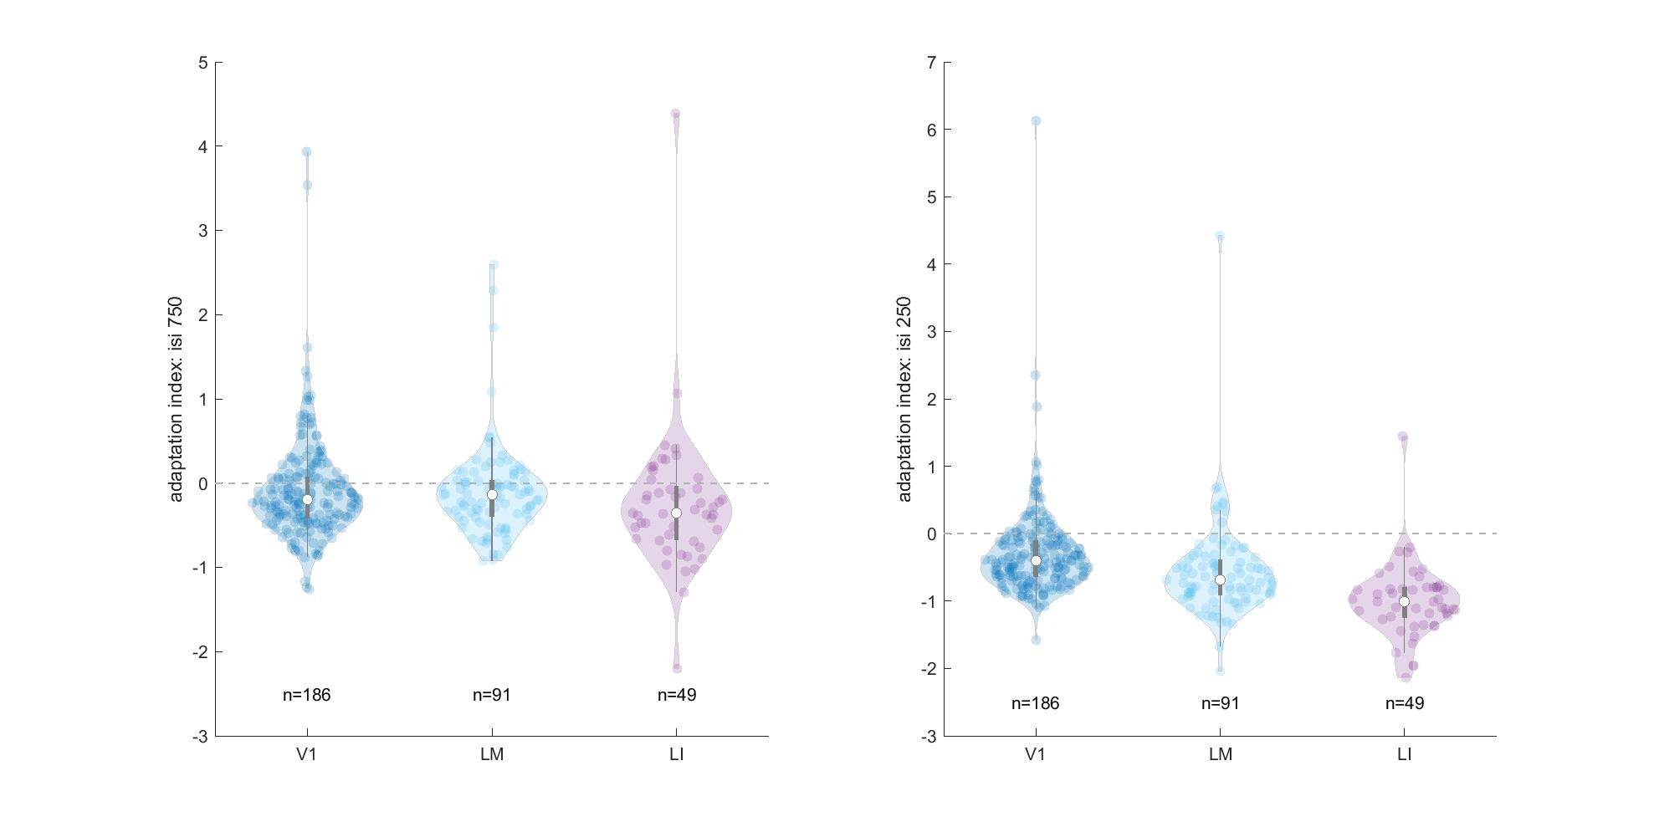
Adaptation index across areas
Notes:
quartiles(2)+-1.57*IQR/sqrt(length(data))

Slide 3
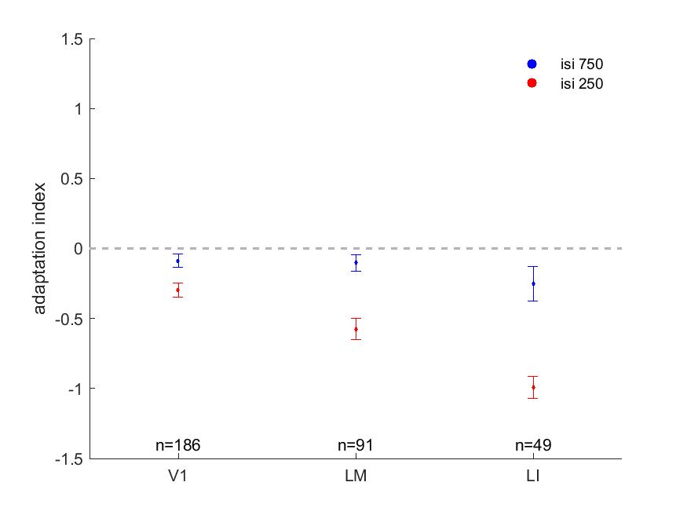
Adaptation index across areas

Slide 4
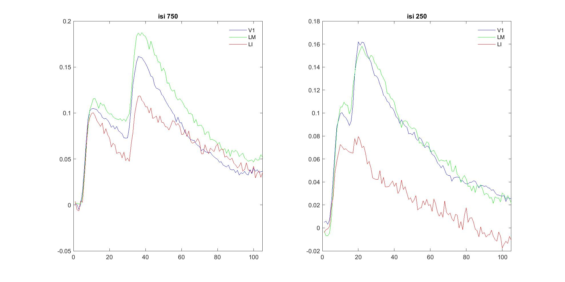
Trace of trials average across areas

Slide 5
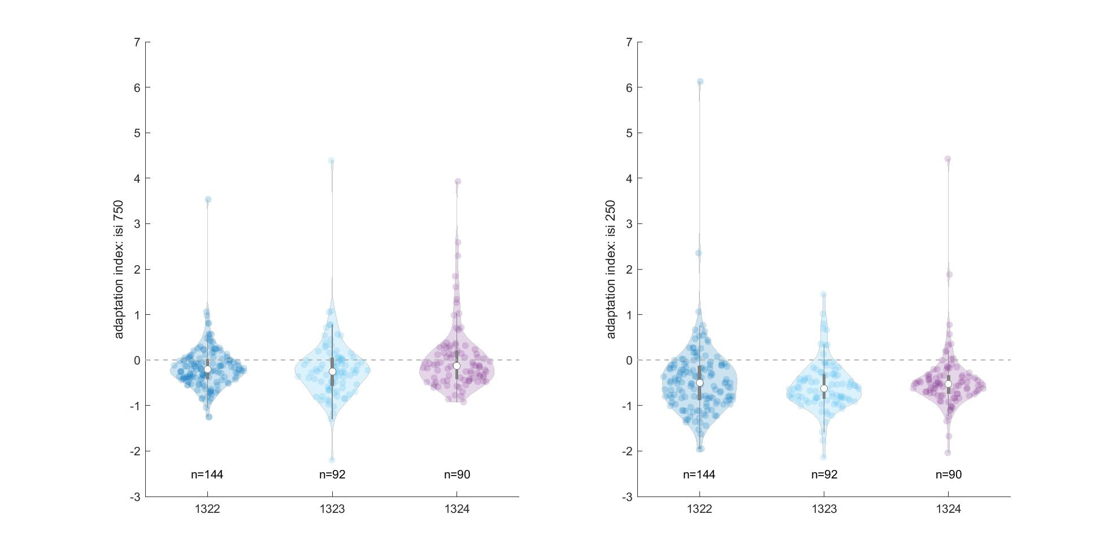
Adaptation index across mice

Slide 6
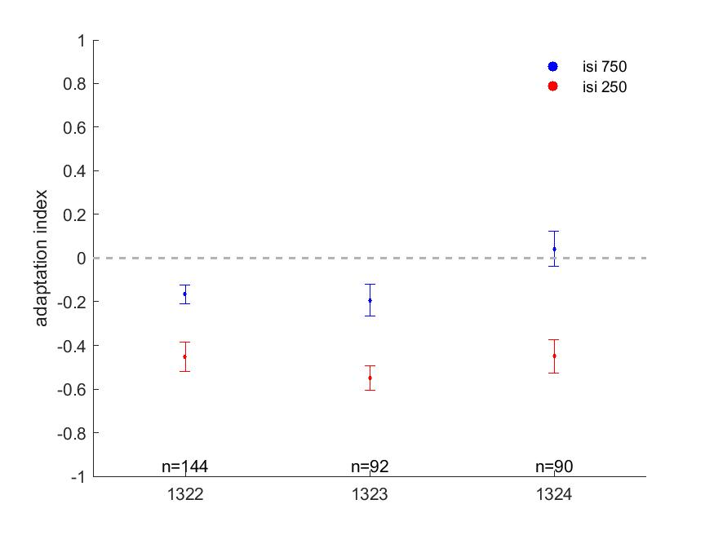
Adaptation index across mice

Slide 7
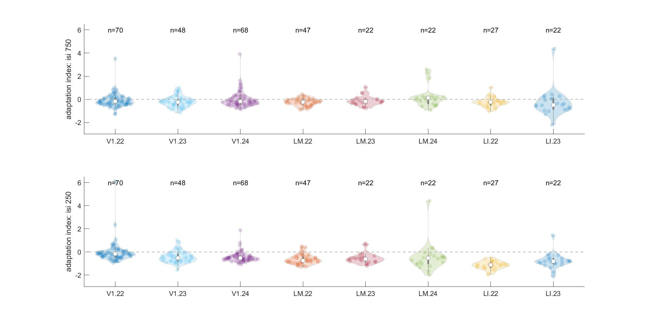
Adaptation index across areas & mice

Slide 8
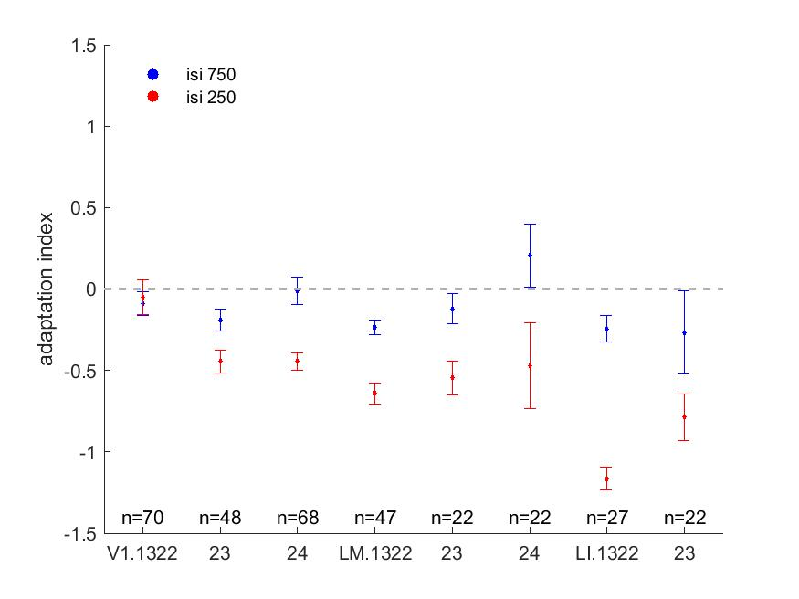
Adaptation index across areas & mice

Slide 9
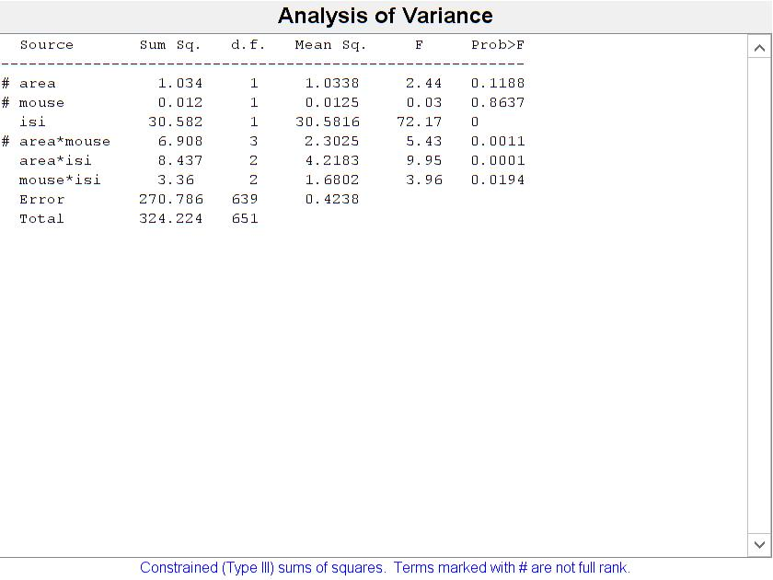
Three-way ANOVA

Slide 10
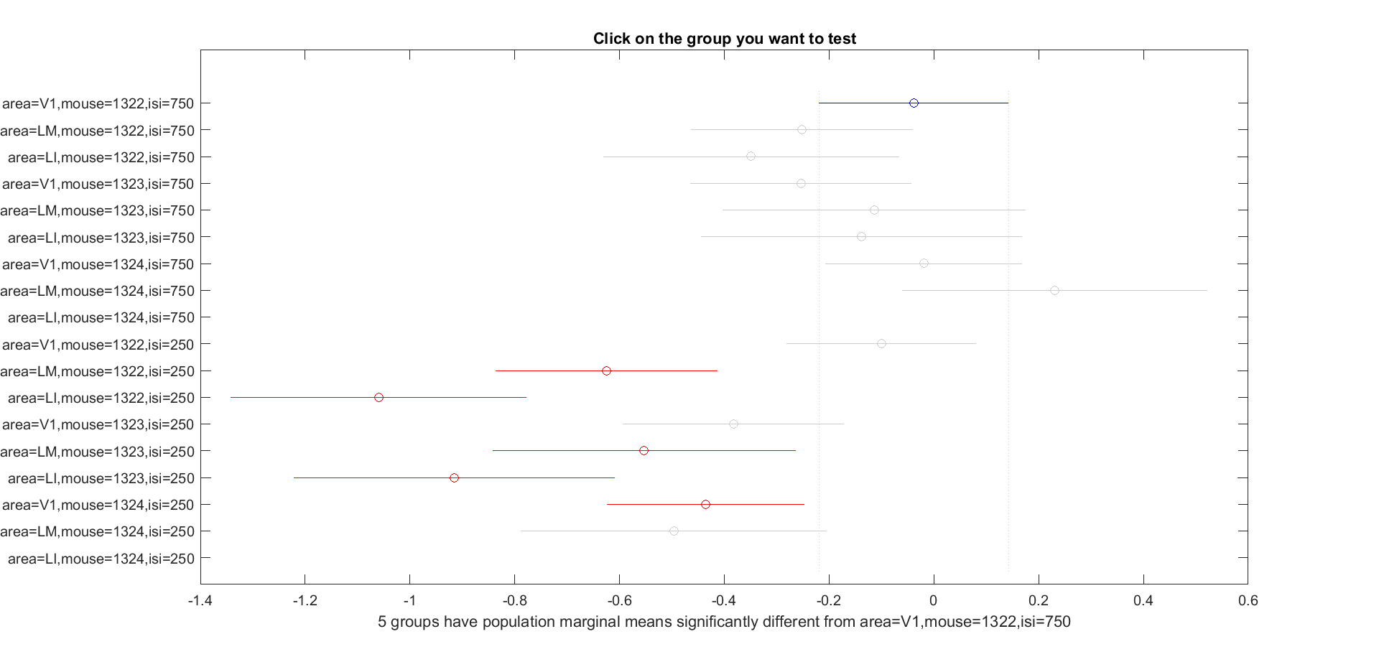
Multiple comparison

